Slide 1

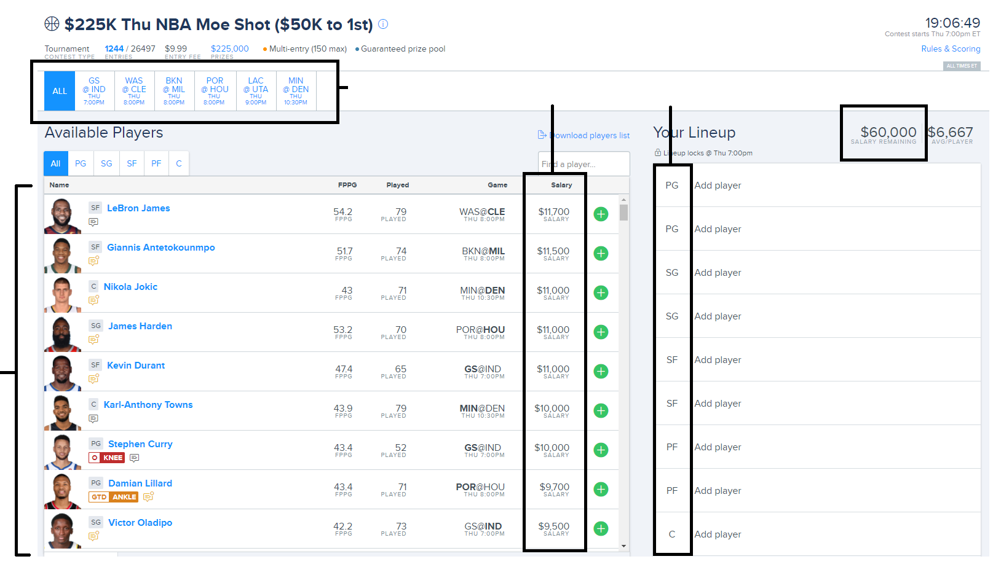

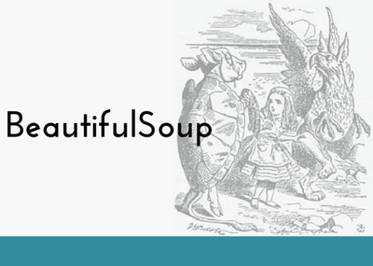

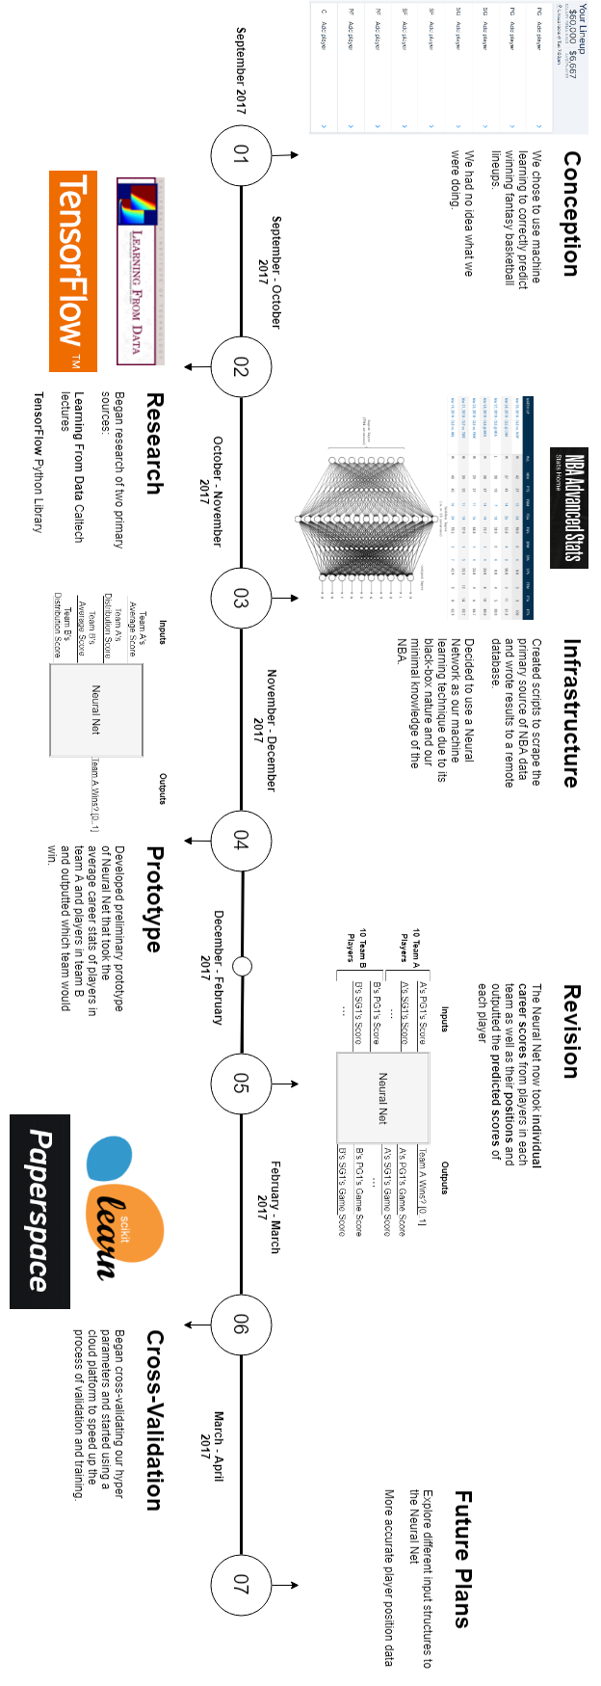
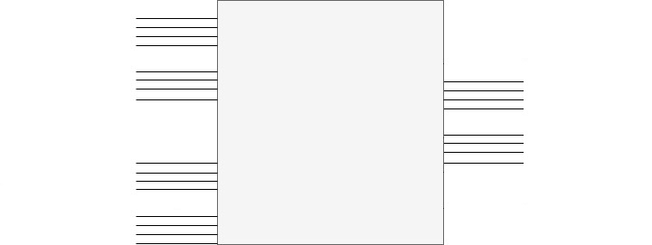
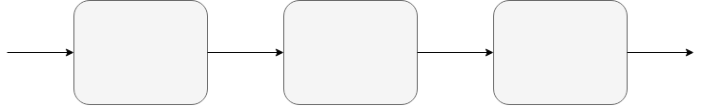
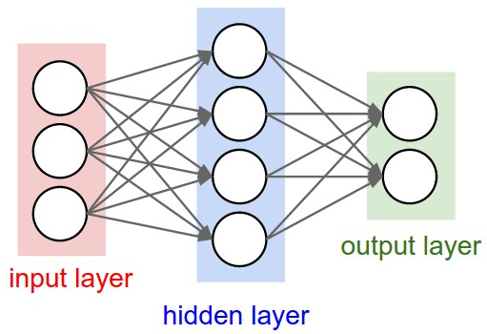
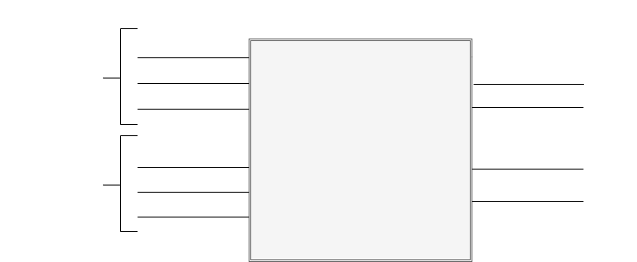

Picking Winners for Fantasy Basketball with Machine Learning
April 5th 2018
ECSE 457
Group 23
Created by: Ege Aydede, Stephen Poole, Florence Regol, Asher Wright
Supervised by: Dr. Psaromiligkos
1
3
6
8
Objective & Background
Data Collection
Results
Timeline
The goal of this project was to make a machine learning system that could compete profitably in daily fantasy NBA competitions.
Daily: happen every day that there are matches, and never last more than a day
Fantasy: uses an artificial points system (e.g. 1.2 points for a rebound)
NBA: based on actual NBA games
Competitions: Actively competing against other real people (or machines?)
In these competitions, you have to select 9 basketball players of specific positions (center, forward, etc.) who are playing tonight, in real games, across any teams. Each player has a salary, and you have a budget. The goal of the competition is to maximize the amount of fantasy points your lineup gets.
With the model for our system chosen, we could begin collecting our data. The inputs to our system are NBA statistics. We built a scraper to grab data from the NBA website. We scraped partial data from games back to 1970, and complete back to 2004:
Defining a success metric for our lineups was nontrivial. The ideal metric is the profitability of the system, but this is incomputable without competition history. Thus, we selected a heuristic metric: the lineup’s score relative to that of the best possible lineup that day.
$$Sucess\left(lineup\right)= \frac{lineup^{′}s fantasy score}{best lineup^{′}s score}$$
By looking at current competitions, we determined that this heuristic implies profitability at around 80% and greater.
<< show example>>
After definining our success metric, we decided it was time to perform cross-validation. Cross-validation is a method of selecting the best hyperparameters of a machine learning system. It is a way to choose the number of hidden nodes, hidden layers, learning rate, and any other aspects of the system that will maximize the accuracy of the system. This is a computationally heavy process, and so we rented a GPU from PaperSpace.
Once cross-validation was complete, we started joining competitions. We ran into some issues:
- Non-updated database
- Players who weren't likely to play that night
- The system throwing out games without certain positions
- Using the wrong data for a player
We solved these issues and kept going. To our surprise, the system was successful. Below are screenshots of each of the competitions we played in where all of our players played.
<<screenshots>>
One can see that, even in the competitions we lose, we do not perform that poorly.
There are also some really cool takeaways:
- Sometimes predictions are really neat
- <<covington two days in a row>>
- Sometimes we guess people who other people don't guess (our NN sees something!)
- <<high scoring barely picked>>
But who are we up against? Pros!
<<screenshot>>
A blue star means they have been in over 1000 competitions and have won money
A white star means they have been in at least 500
By empirically looking, we found that ~85% of people are experienced in these competitions! There are beginner competitions, but that is not scalable!
Our neural network was able to break even even at a level dominated by competitive players.
Today’s
Games
Player
Salaries
Required
Positions
Budget
We used Python to power our scraper,
the BeautifulSoup library to access the NBA website,
and Selenium to control the NBA website
4
Today’s
Players
Architecture
Our first idea was to have a NN with many inputs per active player in the NBA: their stats, and an “are they playing tonight” indicator. The NN would have one output per player: a value indicating if the player should be in the lineup.
Our goal was to build a machine learning system that could predict these lineups and maybe even win some money (unlikely!)
All currently active players’ stats
…
Lineup
indicators
Neural
Network
“Who’s Playing” indicators
…
…
2
Concept: Neural Networks
This model had limitations:
It would be tough for the network learn what the inputs mean
Active players by nature have limited data (can’t use 1995 data)
The network will find correlations between players in different games
The salary constraint is not handled
Instead, we spent time on architecture, and came up with a much better solution:
We decided to use a neural network (NN) to solve our design problem. A NN is useful under the following criteria, which our design problem met:
There has to be a distinguishable pattern between the inputs (player stats, games happening) and the outputs (lineups) of the system.
The relationship cannot be trivially represented mathematically, otherwise no reason to use machine learning
There must be enough data to properly "train" the network
But what is a neural network?
Below is a graphic of a simple NN, with one hidden layer, two outputs, and three inputs. This network, for example, could be attempting to find the relationship between the age, weight, and height of a person and their country of birth and gender.
Data
System 1
Player Scores
System 2
Matches NN
System 3
Lineup ILP
Lineups
System 1 is unrelated to the neural network and computes the players' "scores" with a simple function. The scores roughly represent how good the players are at scoring fantasy points.
System 2, the neural network, now computes the “game scores” of players: a prediction of how many fantasy points they will get in a specific game. The NN is trained and tested on single matches, with far fewer inputs (42). The inputs are the players’ season scores and their recent scores, both computed by System 1. These inputs are sorted by position, as can be seen below:
A
C
System 1 Scores
Game Scores
W
G
Inputs for 7 Team A Players
PG Season
A’s PG game score
H
PG Recent
A’s SF game score
SF Season
Inputs for 7 Team B Players
…
System 2 Matches NN
…
PG Season
B’s SF game score
PG Recent
B’s SF game score
SF Season
…
There are two main "stages" of a Neural network.
1. Feed forward, or how outputs are computed from inputs
When feeding an input through the network, every edge (line) is a weight to multiply the value by, and every node (circle) is an "activation function" on the incoming value.
2. Back propagation, or how the system learns
Once an input is fed through the network, the error or cost of the input can be calculated. <<Equation>> The goal then is to change the weight values on the edges to reduce this error! We do this by "backpropagating" the error through the network. Then, the weights are changed, and the network will perform better on the input. The amount of impact the error has on the weights is called the learning rate.
…
7
This network is not tied to specific players. We lose this information, but in turn we get to train this on all NBA matches, not just the ones with active players. As well, now that we test matches individually, they are independent, and there is no correlation. We have solved the first three limitations!
System 3 solves the fourth limitation: the salary constraint problem.
Given a bunch of players with scores, positions, and salaries, under positional constraints and a salary budget, pick a lineup to maximize the total score.
We solved this problem using a Python library called PuLP – a linear programming optimization solver.
We were then able to get multiple lineups by adding random Gaussian noise to the outputs of the NN before feeding them to the LP problem.
Future Plans
We did not think our network was going to be nearly as successful, but it is still far from perfect, and not completely profitable. We plan to continue to pursue and improve this project. Some ways to improve include:
Figure out noise better
Add additional valuable features
Define a better score function
Perform more thorough cross-validation (e.g. on data amount used)
Performing Boosting or Bagging
Factor standard deviation into LP
Find more precise player positions
Referenced within:
[1]
[2]
[3]

